Slide 1


MINI PROJECT SEMINAR
ON
“Li-Fi DATA TRANSFER SYSTEM”
BY
P MOURYA DEEPAK
V REEMA RANI
G AMARNATH
MENTOR: Mr. A. BALA RAJU M.E., B.TECH, PH.D.*
DEPARTMENT OF ELECTRONICS AND COMMUNICATION ENGINEERING

Slide 2
INTRODUCTION
Li-Fi technology utilizes LED’s for transmitting data. It is subsidiary of optical remote communication technology utilizing light from Led to convey rapid communication.
So here we develop a data transfer system that uses the Li Fi technology. This system serves the following advantages: •High Speed Data Transfer •No Wires Needed •Reliable Communication with No Data Loss •Low Cost of Developing the System
The system allows us to use LI-FI medium for data transfer. We make use of a Li-Fi transmitter android app to demonstrate this concept.
The app converts written text message into light flash data for transmission. The user needs to start the app and type the message to be transmitted.
App controls the mobile phone flashlight to transmit the message. The atmega microcontroller decodes and processes the message sent and then displays it over an LCD display to complete the data transmission.

Slide 3
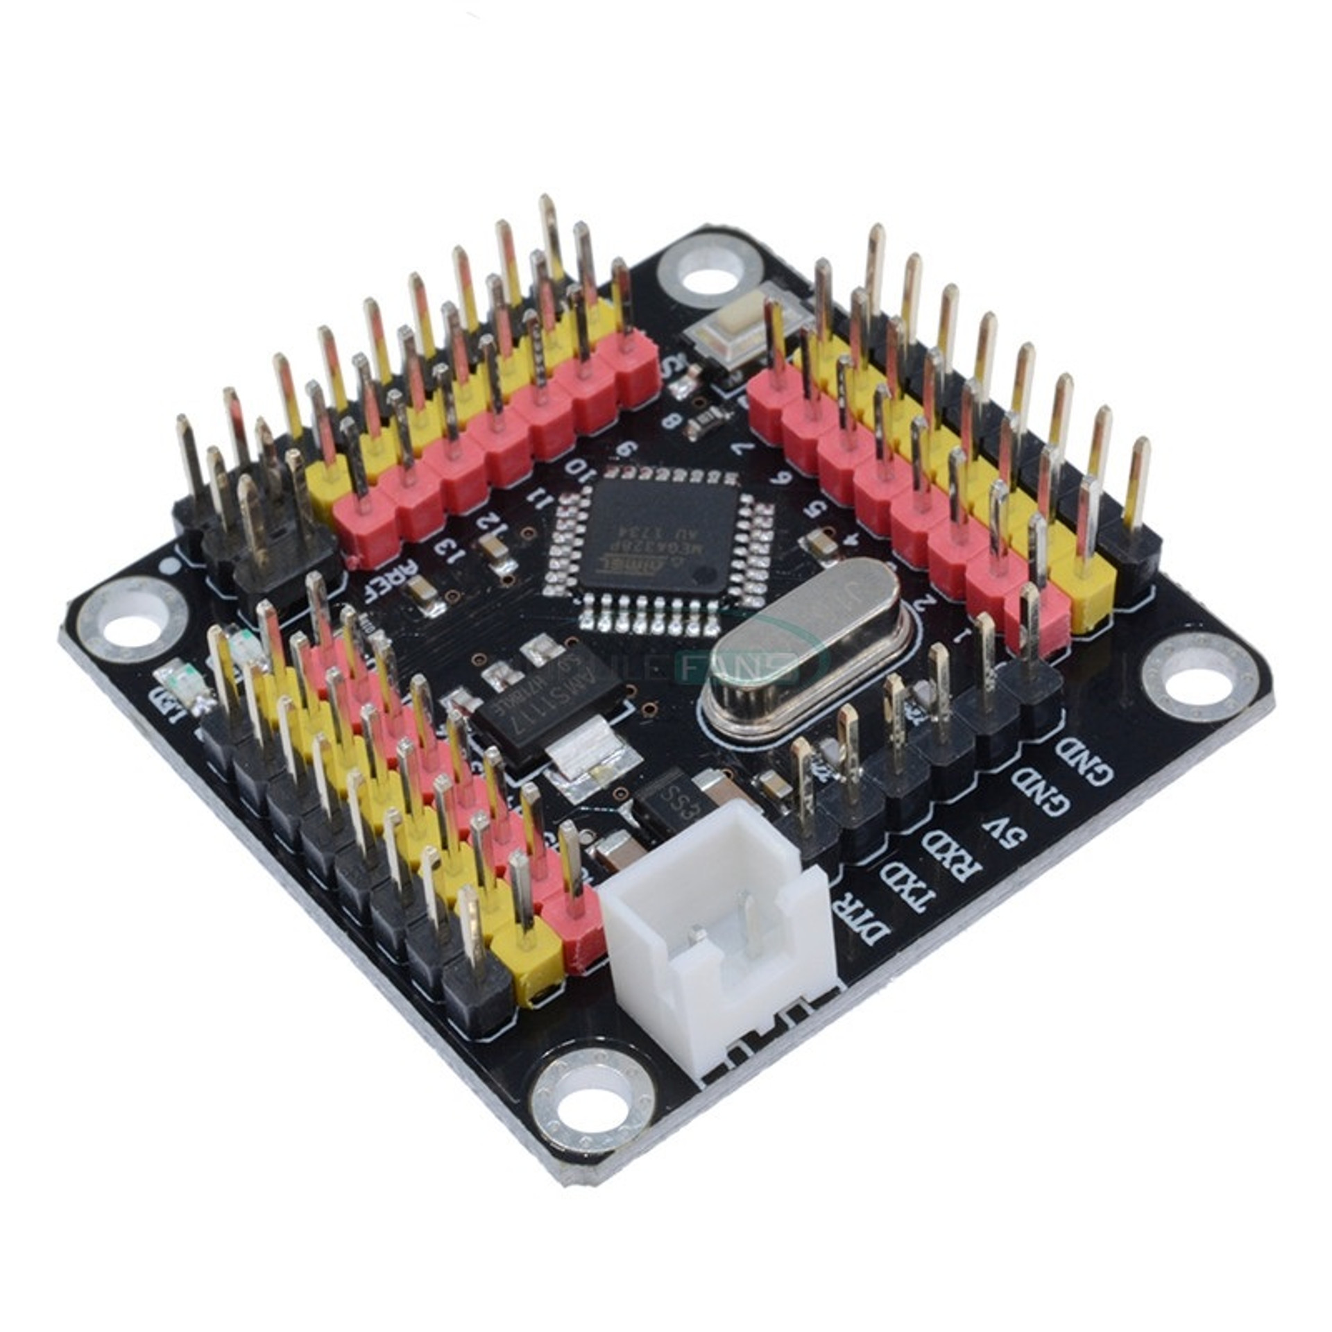
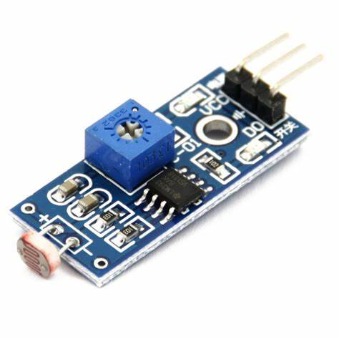
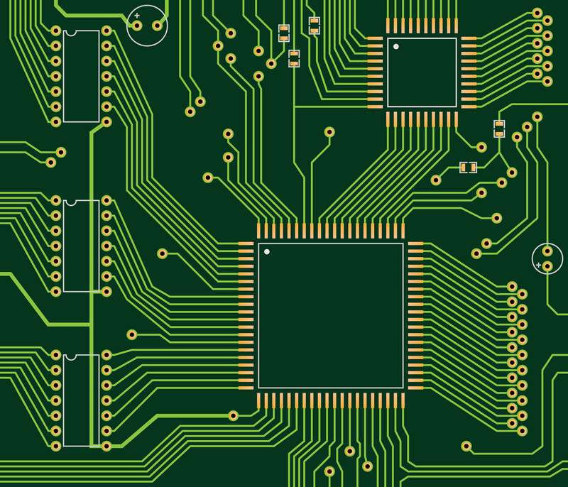
COMPONENTS
Atmega 328 Controller
Push Buttons
LDR Sensor
Regulator Circuitry
Switches
LED’s
PCB Board
Resistors
Capacitors
Transistors
Cables and Connectors

Slide 4
SOFTWARE
C# language is use to create user interface to control Arduino. The serial communication is established between pc and Arduino.
GUI is used to transfer the signal from computer to microcontroller to perform the operation for which it is made.

Slide 5
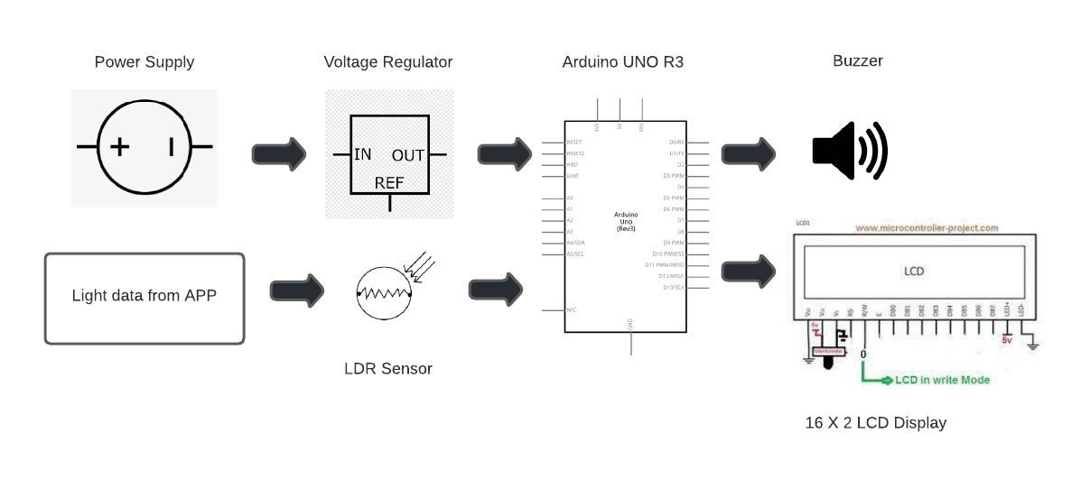
BLOCK DIAGRAM

Slide 6
APPLICATIONS
Li-Fi technology in Hospitals
Li-Fi in the Workplace
Secured connection data transfer
Speed data transfer
Li-Fi and Industry
Li-Fi and Military
Communication Underwater
Communication in dangerous Environments or In Sensitive regions

Slide 7
THANK YOU

